Slide 1
2F Scanner
FACIAL Recognition using OpenCV
BY CHIGOZIE AHAM

Slide 2
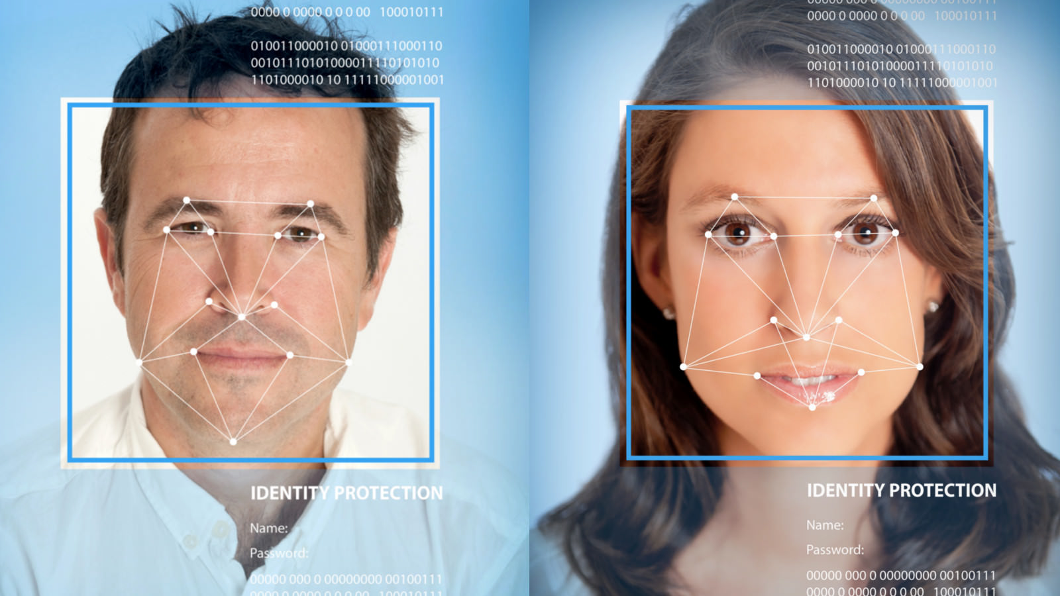
BACKGROUND
2F Scanner is a device that performs the functions of facial detection for signing up users and facial recognition for giving access/privileges to specific users. It is designed to work with GBMstats software application. GBMstats is an android software that could be used for monitoring live camera feed through a mobile device. 2F Scanner could be used alternatively to signup and login users, instead of the traditional way (manually entering login credentials).

Slide 3
COMPONENTS
There are two major hardware components, which are:
Raspberry pi 3
Arducam pi-camera
The software components consist of:
Linux core
OpenCV 3.1 library
Python 2.7
Raspbian OS
Making of the 2F Scanner

Slide 4
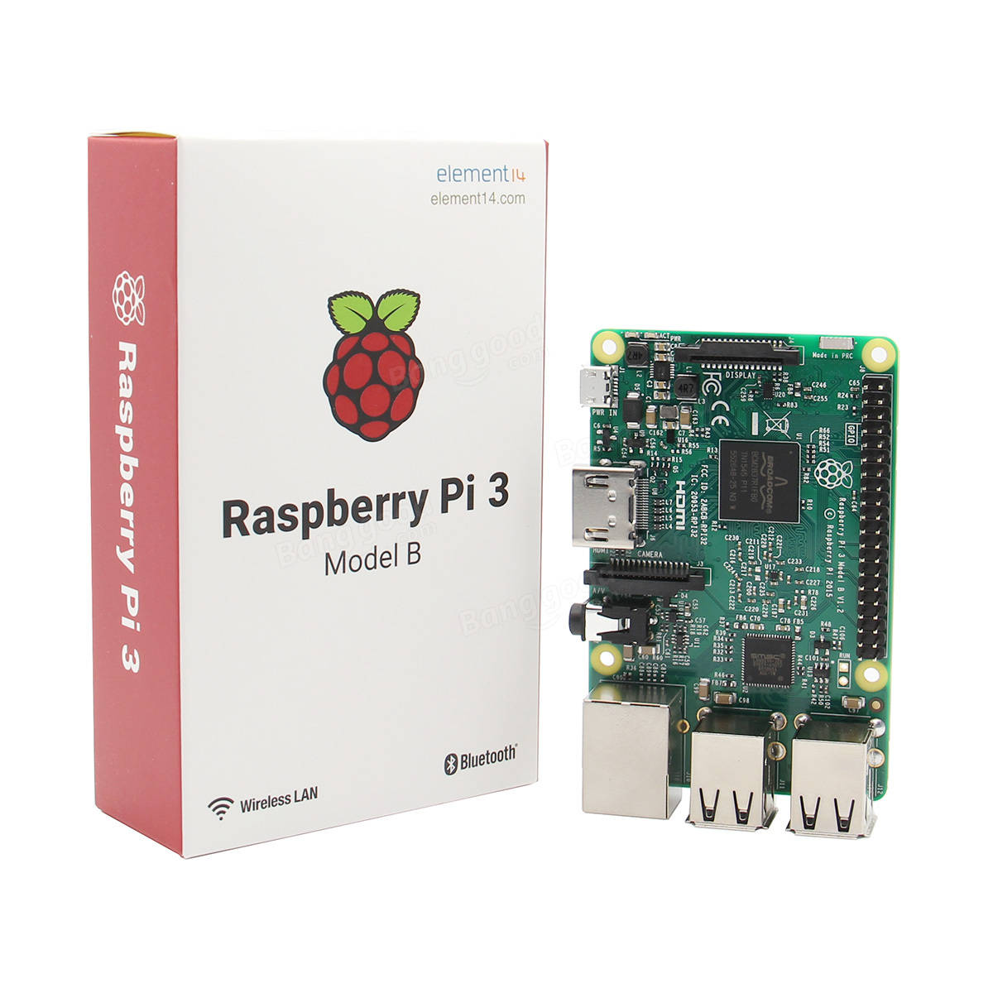
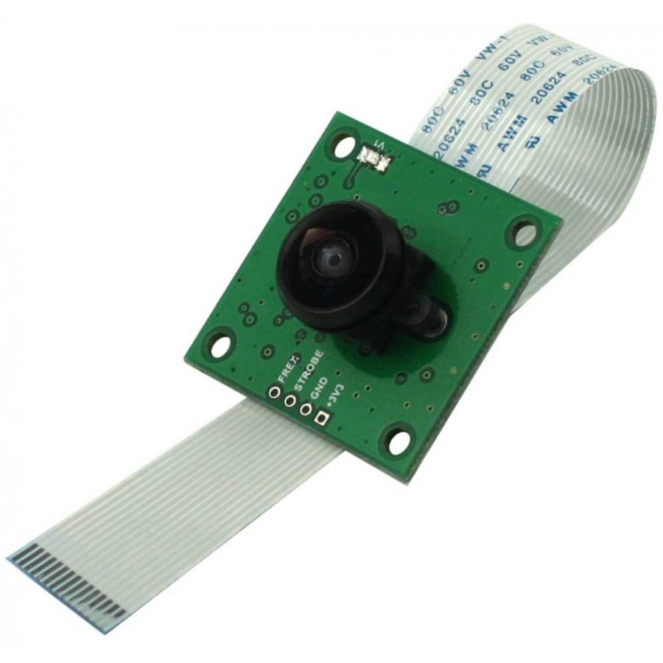
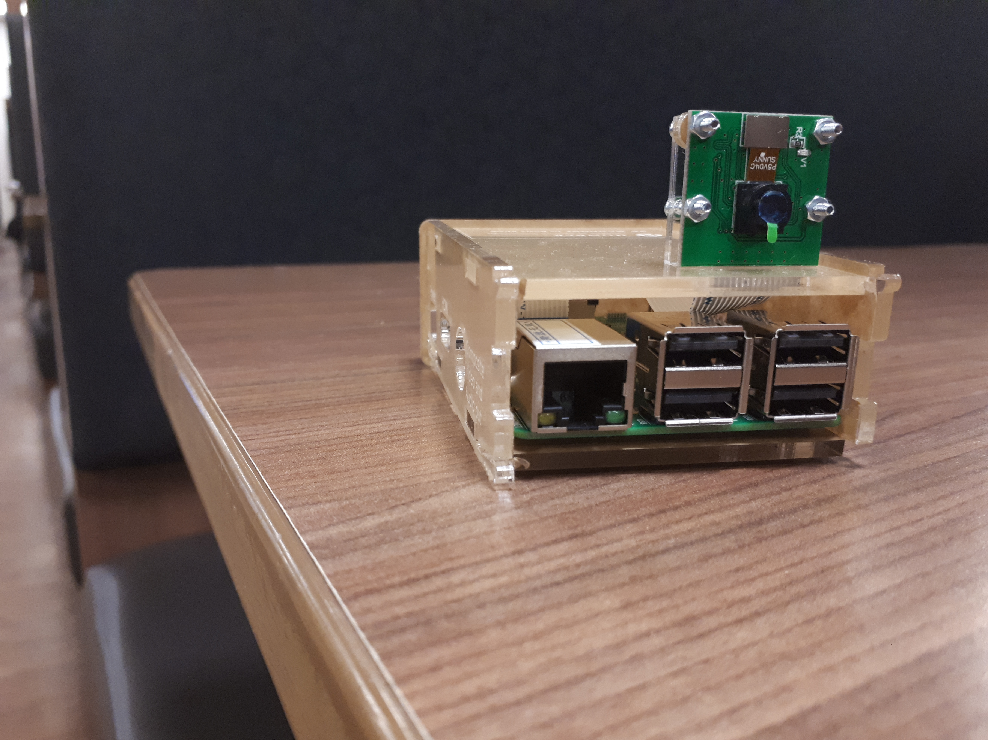



Budget and Hardware parts
$$+$$
$$=$$
Raspberry pi 3 - $44
Arducam pi camera - $21.63
$$2f Scanner$$

Slide 5
Resources needed for Successful testing
Xml file for reading different facial descriptions
Python code for compiling computer instructions
Linux commands for setting up video recording
Good background lighting
OpenCV library functions for facial detection and recognition

Slide 6
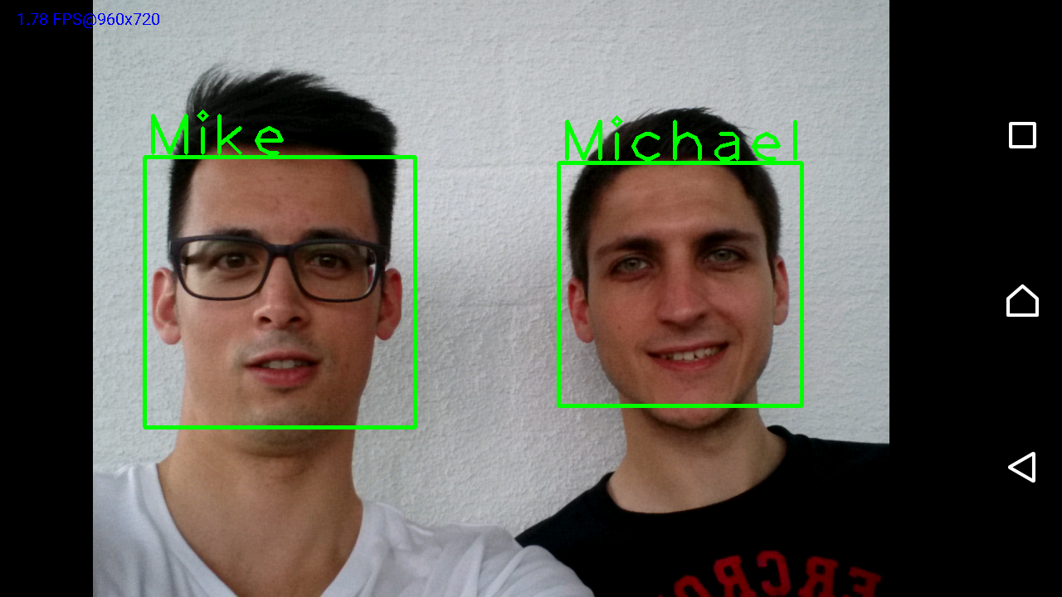
Guide
To sign up, user is prompted to enter their username and then video camera is enabled to capture 20 images of the user. The amount of images is to guarantee efficiency, so that the different angles/facial expression of the user can be captured. Next, the pictures are saved in the database. An image is only captured when a face is detected.
Next, the captured images are trained.
Finally, video camera is enabled again. This time to identify the faces being recorded by the usernames entered.

